Slide 1
Land Administration And Management
Basic knowledge on land registration and management
Able to learn and understand the theory of Land Administration
to know the real problem in Land registration and management

Slide 2
1. Introduction:
1.1 Land definition
1.2 Concept surrounding Land
1.3 Land - Humankind Relation
1.4 Importance of Land and property
1.5 Land and Economics

Slide 3
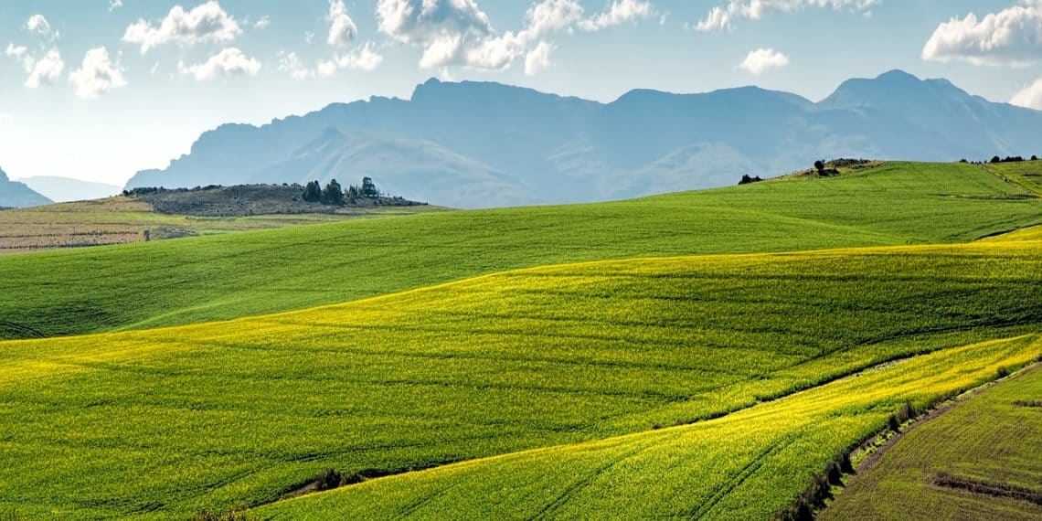
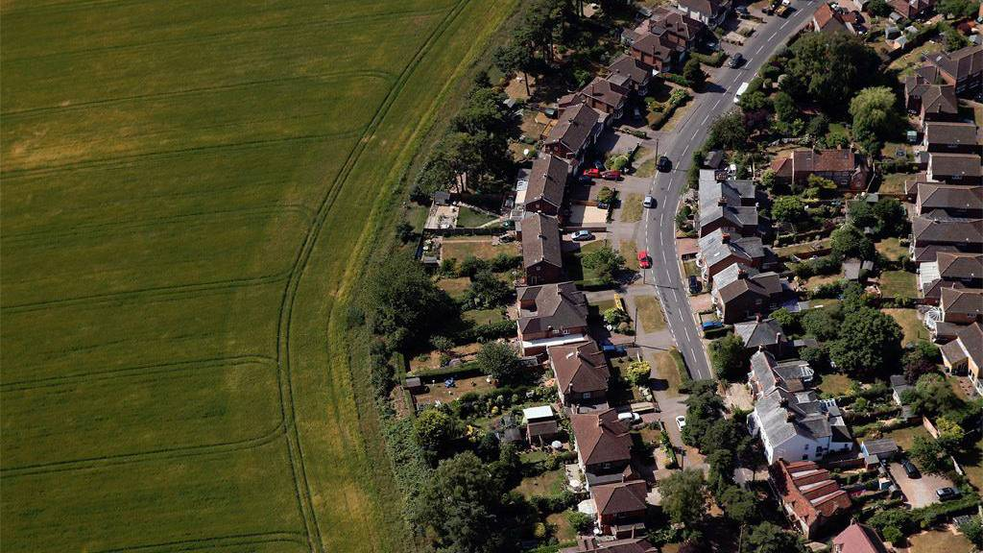
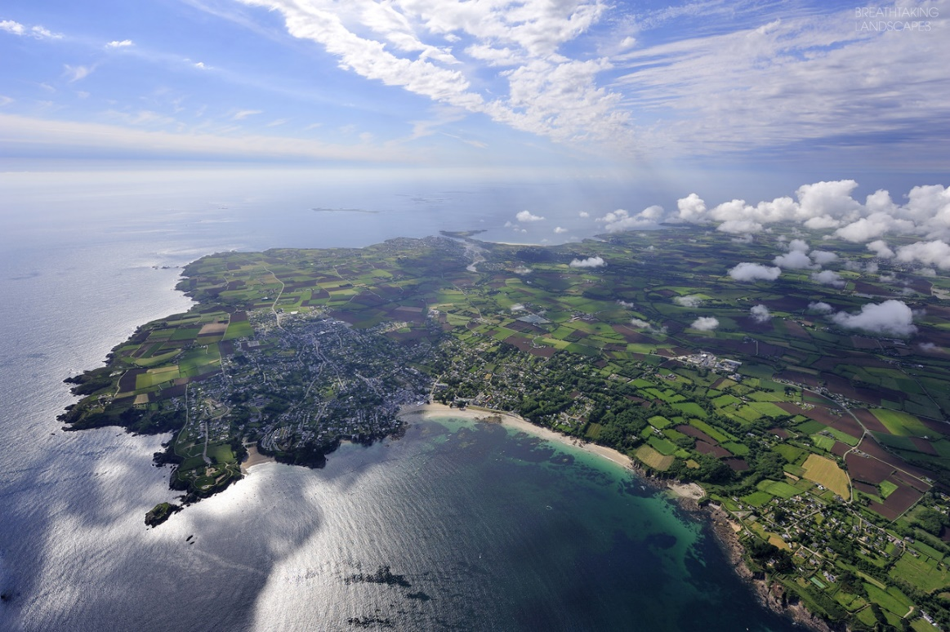
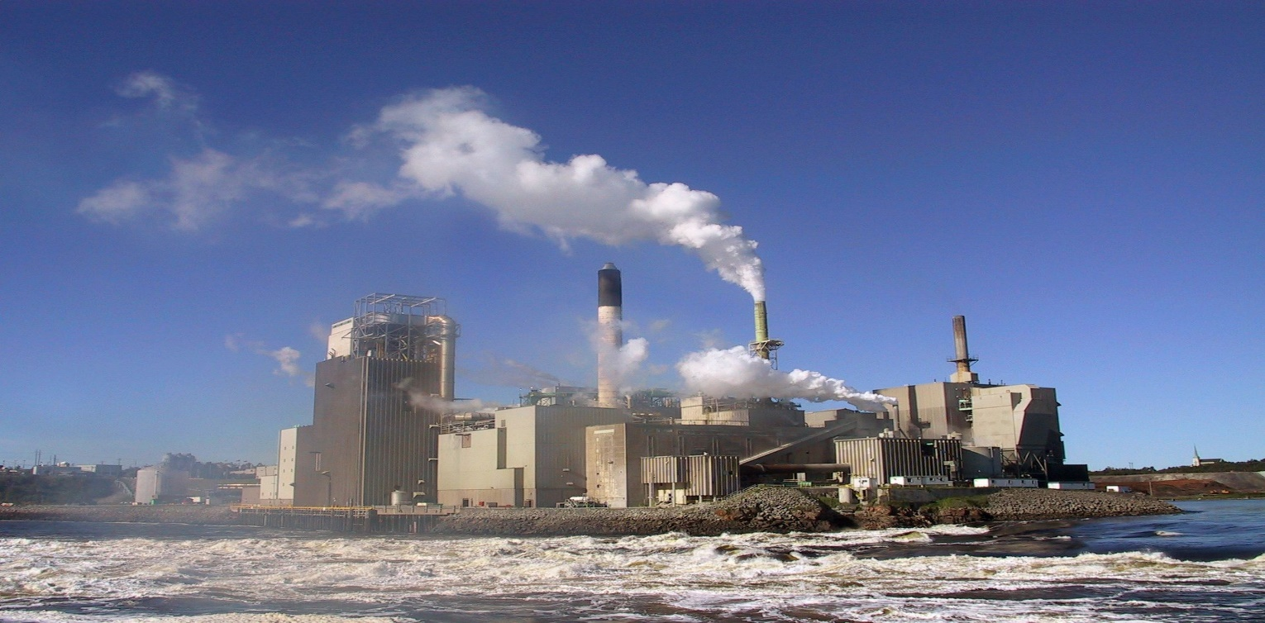
What is Land

Slide 4
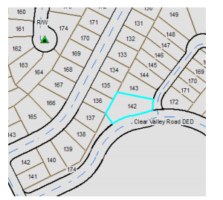
What is Land???

Slide 5
Contd…
“Land" means all categories of land, including those with buildings, gardens, trees, factories, lakes, ponds etc. (Land survey and Measurement Act 2019)
“Plot" means a piece of land that has boarder in all four sides and has similarity in right, possession and grade in each place
https://www.lawcommission.gov.np/np/wp-content/uploads/2021/01/%E0%A4%9C%E0%A4%97%E0%A5%8D%E0%A4%97%E0%A4%BE-%E0%A4%A8%E0%A4%BE%E0%A4%AA-%E0%A4%9C%E0%A4%BE%E0%A4%81%E0%A4%9A-%E0%A4%90%E0%A4%A8-%E0%A5%A8%E0%A5%A6%E0%A5%A7%E0%A5%AF.pdf

Slide 6
Contd..
According to Land Administration Guideline, UN
#. From a legal perspective, land extends from the centre of the Earth to the infinite in the sky.
#.But maximum focus will be on the volume of space that encompasses the surface of the Earth, all things that are attached to it, and the rocks and minerals that are just below it

Slide 7
Land
Land
Physical
surface of the earth and all things attached
Immovable property
Abstract
a set of rights to its use
with value

Slide 8
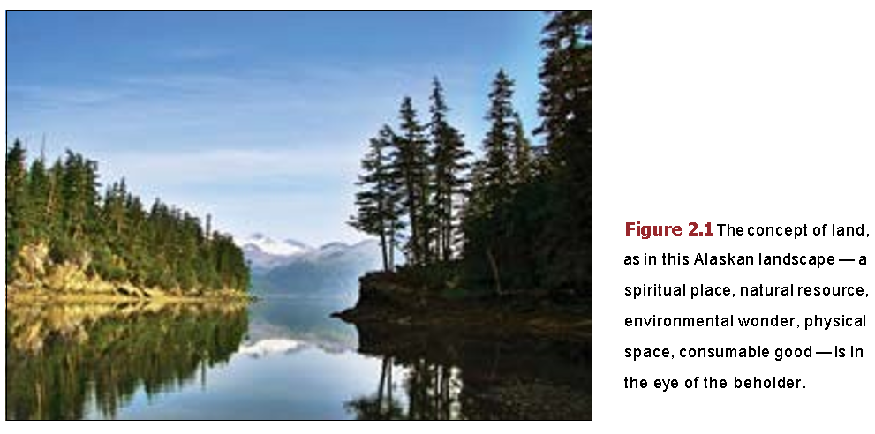
Contd…
Land has both physical (buildings and resources) and cognitive (theory and concept) aspects
Around the world, cognitive approaches to land are remarkably variable, reflecting the different ways people think.
unique social responses to the local landscape.

Slide 9
Contd..
Categories of Land
Government Land
Public Land
Private Land
Trust Land
Land survey and measurement Act - 2019
Land survey and measurement rules - 2058

Slide 10
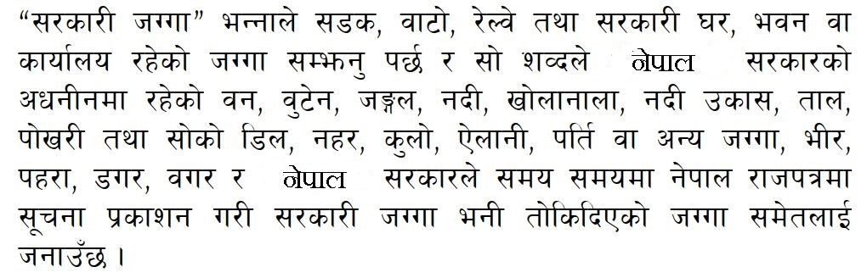
Contd…

Slide 11
Contd…
“Government land" means the land where there exit roads, railway, government building or office and this expression also includes forest, shrubs, jungle, river, streams, Nadi Ukas, lake, pond and ridge thereof, main canal (Nahar), water course (Kulo), (Barron) Ailani, Parti and other types of land, Bhir, Pahara, Dagar, shore (Bagar) which is under the control of Government and such other lands as a Government land as prescribed by Government of Nepal by a Notification in the Nepal Gazette.

Slide 12
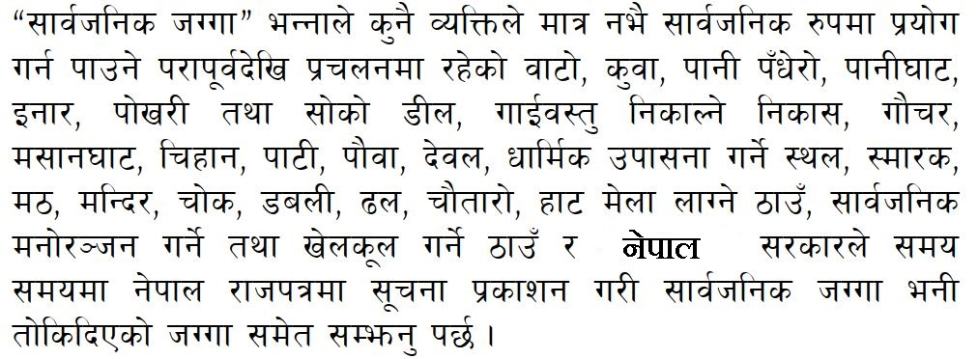
Contd…

Slide 13
Contd..
“Public land" means and includes roads, wells, water conduits, shores, ponds and banks thereof, exits for chattels, pasture lands, graveyards, burial sites, inns, Pauwas, Dewals, religious meditation sites, memorials, temples, shrines, Chowk, Dawali, sewerage, Chautaro, lands where fairs, markets and public entertainment or sports sites are located, which been used publically but nor personally since ancient times, and such other lands as prescribed to be the public land by the Government of Nepal, by a notification in the Nepal Gazette

Slide 14
Contd..
Guthi
Sanskrit word = “Gosti” means council
Those land which are assigned for
Charitable
Religious
Philantropic institution (the love of humanity)
5 types of guthi are still in practice in Nepal
Guthi Tainathi
Guthi Adhinastha
Raj Guthi
Nigi Guthi
Chut Guthi
गुठी-संस्थान-ऐन-२०३३

Slide 15
Concepts Surrounding Land..
Land is a fundamental resource with much of human life, activities and personal property having consequential links with specific pieces of land (Larsson, 1991).
The relationship between humans and land is complex, dynamic, and important to every society throughout history (Ting and Williamson, 1999).
The availability of land is key to human existence and its distribution and use are of vital importance.

Slide 16
Concepts Surrounding Land
The United Nations Economic Commission for Europe estimates 20 % or more of any country’s GDP comes from land, property and related construction (UNECE, 1996).
Land can be traded land which may be considered as an commodity that is immovable and strictly limited in supply; (Dale and Baldwin, 1998).
Land has a certain ‘capital value’ that, when situated within a market economy, becomes ‘activated’ and can inherently generate further value (de Soto, 2000).

Slide 17
Land and Humankind
Land is the ultimate resource for life, without which life on earth cannot be sustained.
Land is considered as Wealth, Commodity, Scarce Resource and Community Resource
Land is principal source of livelihood for majority of the Nepalese People
Relation
Land
Humankind

Slide 18
Relations
Humankind
Who ?
Relation
What ?
RRR:
Right
Responsibility
Restriction
Land
Where ? & How much ?
The most important relationship is the ownership
Conceptual model

Slide 19
Importance Of Land And Property
Value as a source of food
Economic value
Ecological value(relation of living organism to one another and their
physical surrounding)
Socio-cultural value
Political value

Slide 20
Land and Economics
Land and buildings are important financial asset.
All investment depend on land. (Hydropower, housing complex, irrigation etc)
Land for mortgage system.

Slide 21
Assignment-1
Explain types of Guthi
Guthi Tainathi
Guthi Adhinastha
Raj Guthi
Nigi Guthi
Chut Guthi
2. Choose one place (land) from your locality and case study about the belief, that the people had in that land and how that particular land had been utilized till now?
3. Find out one agricultural(productive) area in USA and describe how the agricultural land is being utilizes and also illustrate the cadastral system of that state?

